Slide 1
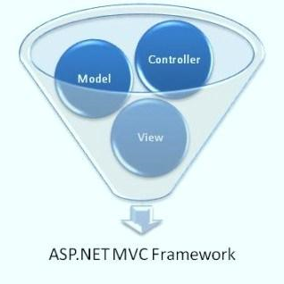



Introduction to ASP.NET MVC 4
Nikolay Kostov
Senior Software Developer and Trainer
http://nikolay.it
Telerik Software Academy

Slide 2

Table of Contents
The MVC Pattern
ASP.NET MVC
Installation and Creating of ASP.NET MVC Project
ASP.NET MVC Routing
Controllers and Actions
Razor Views
Areas
Kendo UI Widgets

Slide 3
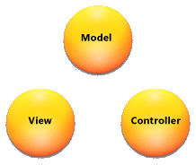
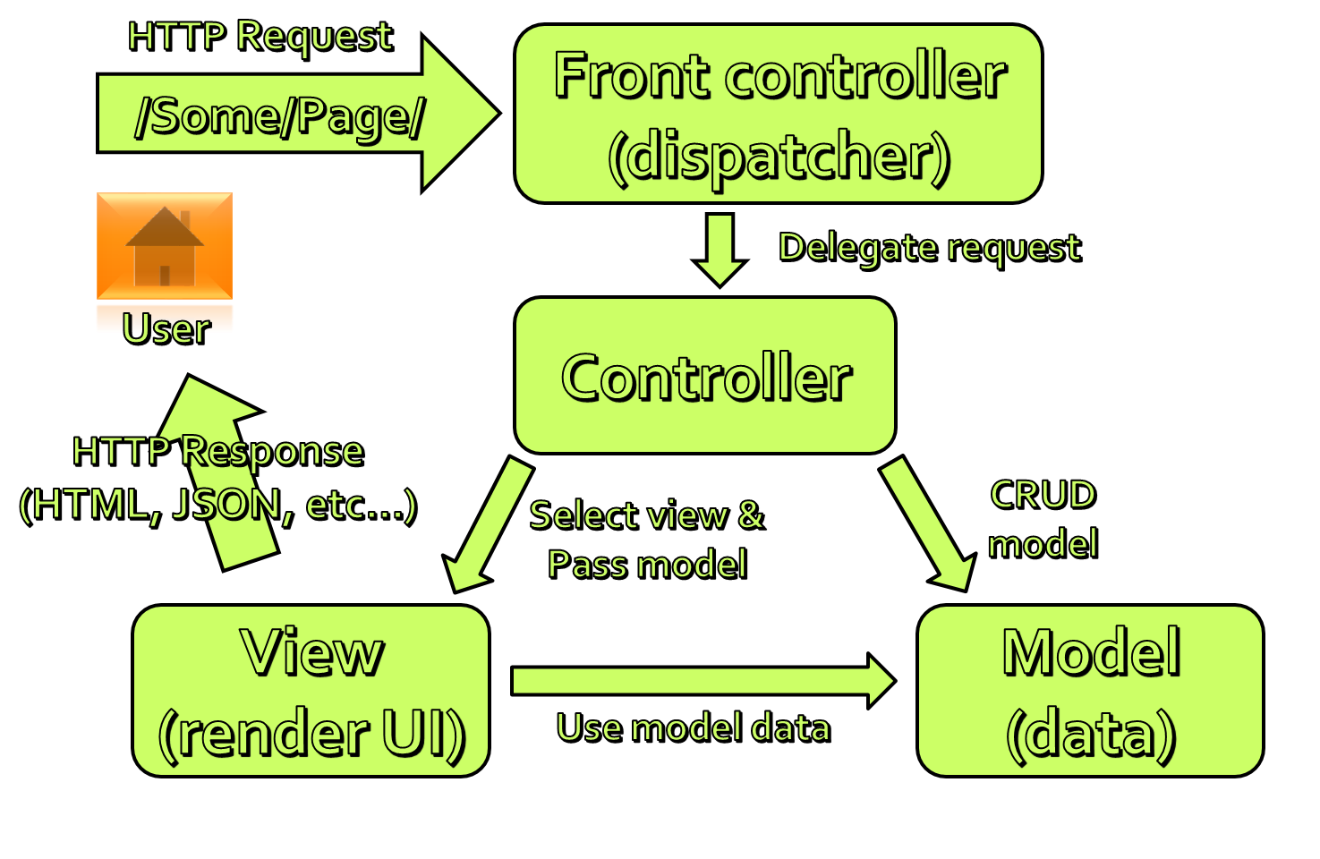
The MVC Pattern

Slide 4
The MVC Pattern
Model–view–controller (MVC) is a software architecture pattern
Originally formulated in the late 1970_{s} by Trygve Reenskaug as part of the Smalltalk
Code reusability and separation of concerns
Originally developed for desktop, then adapted for internet applications

Slide 5

Model
Set of classes that describes the data we are working with as well as the business
Rules for how the data can be changed and manipulated
May contain data validation rules
Often encapsulate data stored in a database as well as code used to manipulate the data
Most likely a Data Access Layer of some kind
Apart from giving the data objects, it doesn't have significance in the framework

Slide 6


View
Defines how the application’s user interface (UI) will be displayed
May support master views (layouts) and sub-views (partial views or controls)
Web: Template to dynamically generate HTML

Slide 7
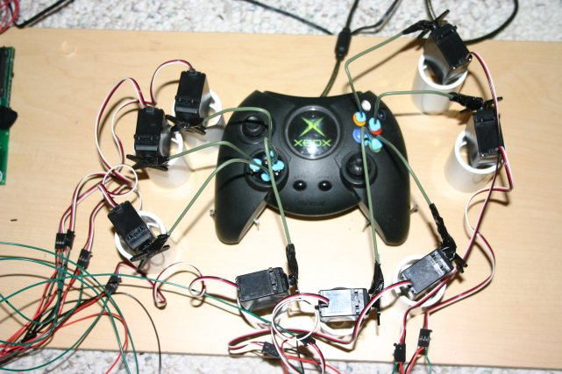
Controller
The core MVC component
Process the requests with the help of views and models
A set of classes that handles
Communication from the user
Overall application flow
Application-specific logic
Every controller has one or more "Actions"

Slide 8
MVC Steps
Incoming request routed to Controller
For web: HTTP request
Controller processes request and creates presentation Model
Controller also selects appropriate result (view)
Model is passed to View
View transforms Model into appropriate output format (HTML)
Response is rendered (HTTP Response)

Slide 9
The MVC Pattern for Web
HTTP Request
/Some/Page/
Front controller (dispatcher)
Delegate request
User
Controller
HTTP Response
CRUD model
Select view & pass data
View
(render UI)
Model (data)
Use model data

Slide 10
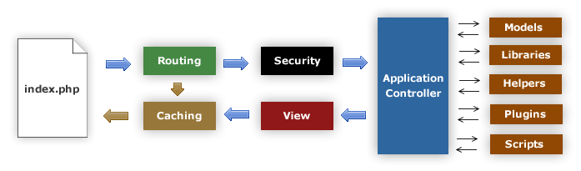
MVC Frameworks
CakePHP (PHP)
CodeIgniter (PHP)
Spring (Java)
Perl: Catalyst, Dancer
Python: Django, Flask, Grok
Ruby: Ruby on Rails, Camping, Nitro, Sinatra
JavaScript: AngularJS, JavaScriptMVC, Spine
ASP.NET MVC (.NET Framework)

Slide 11
ASP.NET MVC

Slide 12
ASP.NET Core
ASP.NET WebForms
ASP.NET
MVC
Presentation
ASP.NET
Caching
.NET
Globalization
Pages
Controls
Master Pages
Runtime
Profile
Roles
Membership
Routes
Handlers
Etc...

Slide 13

ASP.NET Web Forms
Stable and mature, supported by heaps of third party controls and tools
Event driven web development
Postbacks
Viewstate
Less control over the HTML
Hard to test
Rapid development

Slide 14
ASP.NET MVC
Runs on top of ASP.NET
Not a replacement for WebForms
Leverage the benefits of ASP.NET
Embrace the web
User/SEO friendly URLs, HTML 5, SPA
Adopt REST concepts
Uses MVC pattern
Conventions and Guidance
Separation of concerns

Slide 15
ASP.NET MVC (2)
Tight control over markup
Testable
Loosely coupled and extensible
Convention over configuration
Razor view engine
One of the greatest view engines
With intellisense, integrated in Visual Studio
Reuse of current skills (C#, LINQ, HTML, etc.)
Application-based (not scripts like PHP)

Slide 16
The ASP.NET MVC History
ASP.NET MVC 1.0
In February 2007, Scott Guthrie ("ScottGu") of Microsoft sketched out the core of ASP.NET MVC
Released on 13 March 2009
ASP.NET MVC 2.0
Released just one year later, on 10 March 2010
ASP.NET MVC 3.0
Released on 13 January 2011
ASP.NET MVC 4.0
Released on 15 August 2012

Slide 17
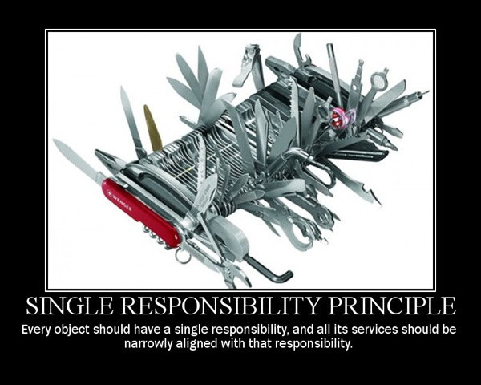
Separation of Concerns
Each component has one responsibility
SRP – Single Responsibility Principle
DRY – Don’t Repeat Yourself
More easily testable
TDD – Test-driven development
Helps with concurrent development
Performing tasks concurrently
One developer works on views
Another works on controllers

Slide 18
Extensible
Replace any component of the system
Interface-based architecture
Almost anything can be replaced or extended
Model binders (request data to CLR objects)
Action/result filters (e.g. OnActionExecuting)
Custom action result types
View engine (Razor, WebForms, NHaml, Spark)
View helpers (HTML, AJAX, URL, etc.)
Custom data providers (ADO.NET), etc.

Slide 19
Clean URLs
REST-like
/products/update
/blog/posts/2013/01/28/mvc-is-cool
Friendlier to humans
/product.aspx?catId=123 or post.php?id=123
Becomes /products/chocolate/
Friendlier to web crawlers
Search engine optimization (SEO)

Slide 20
MVC Pattern in ASP.NET MVC
HTTP Request
Web server
ASP.NET MVC Routing engine
/Users/Niki/
Select controller and invoke action (method)
User
Controller
(C# class)
HTTP Response
(HTML, File, JSON, …)
Select view & pass data (model)
CRUD model
View engine
(Razor)
Model (POCO)
Use model data

Slide 21
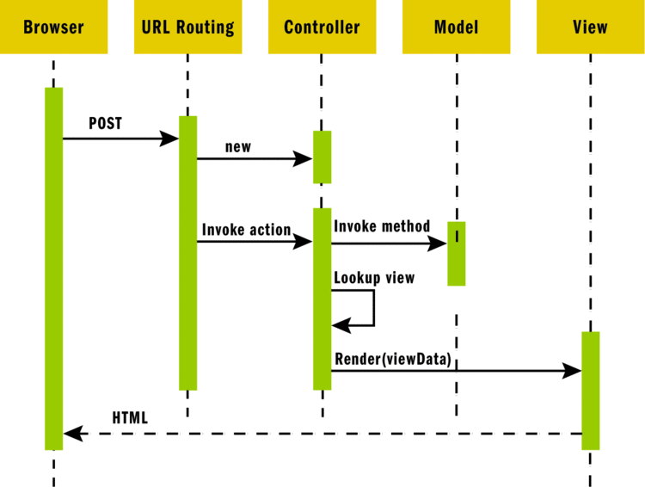
ASP.NET MVC Request

Slide 22
The Technologies
Technologies that ASP.NET MVC uses
C# (OOP, Unit Testing, async, etc.)
HTML(5) and CSS
JavaScript (jQuery, KendoUI, etc.)
AJAX, Single-page apps
Databases (MS SQL)
ORM (Entity Framework and LINQ)
Web and HTTP

Slide 23
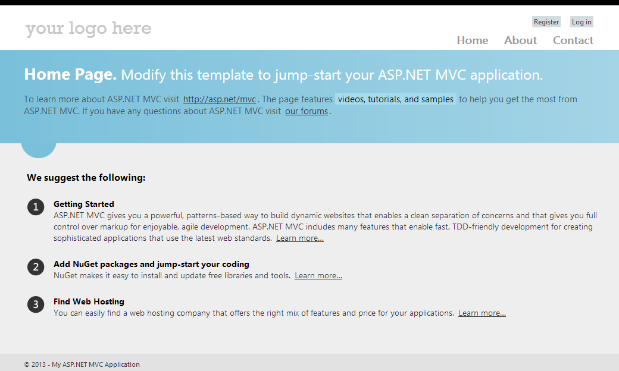
Installation and Creating of ASP.NET MVC Project

Slide 24
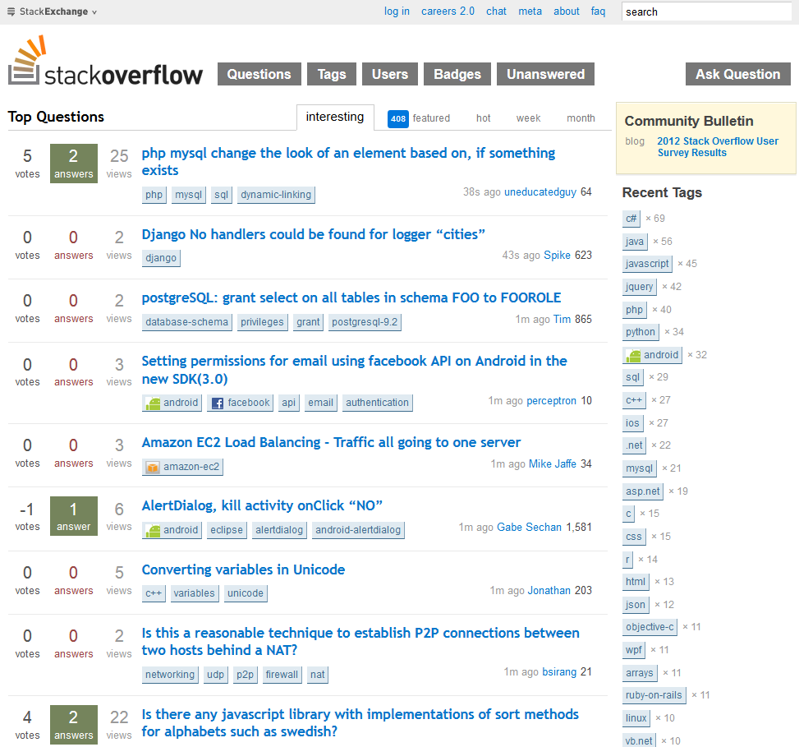
Demo Project
Forum system like http://stackoverflow.com
StackOverflow Forum Internet Application
Features:
User profiles
Forum features
Posting messages
Voting for posts
Administration
Other useful features (tags, search, comments)

Slide 25
The Tools
Tools that we need:
IDE: Visual Studio 2012 (Express for Web)
JustCode and Web Essentals
Framework: .NET Framework 4.5
Web server: IIS 8 (Express)
Data: Microsoft SQL Sever (Express or LocalDB)
Web Platform Installer 4.0 will install everything we need for us
microsoft.com/web/downloads/platform.aspx
Install Visual Studio Express 2012 for Web

Slide 26
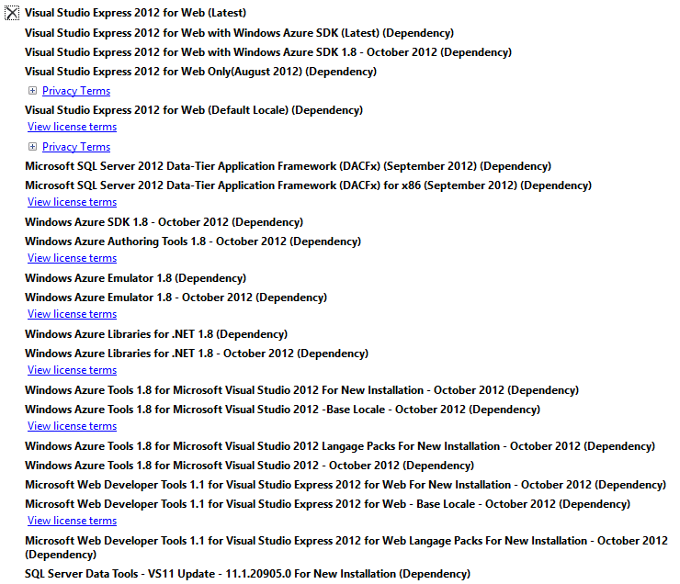
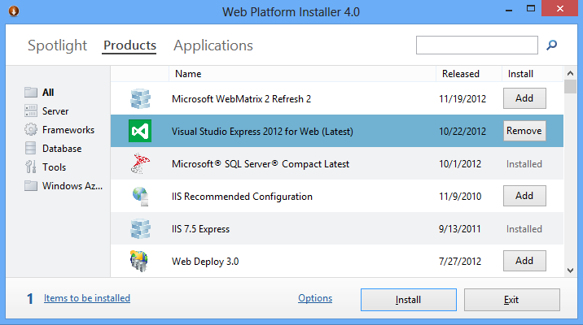
Web Platform Installer

Slide 27
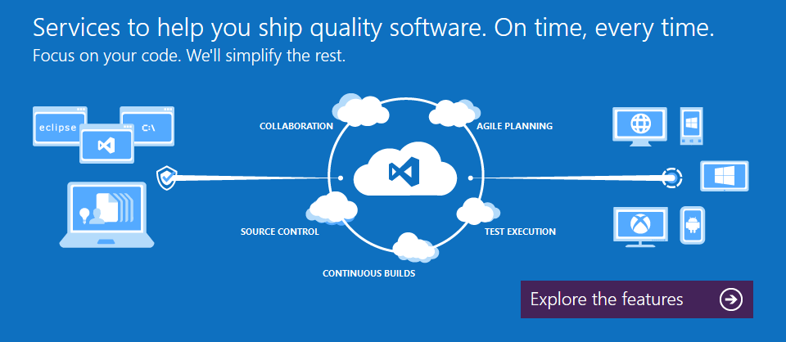
tfs.visualstudio.com
Powered by Microsoft
Collaboration platform at the core of application lifecycle management (ALM)
Source control system (TFS)
Free plan that includes:
Version control
Free builds
Up to 5 users
Unlimited number of projects

Slide 28
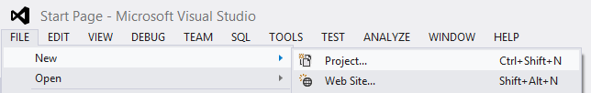
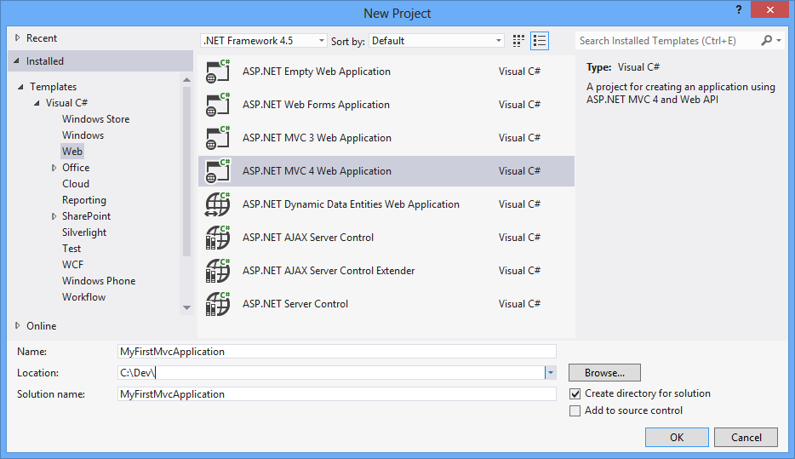
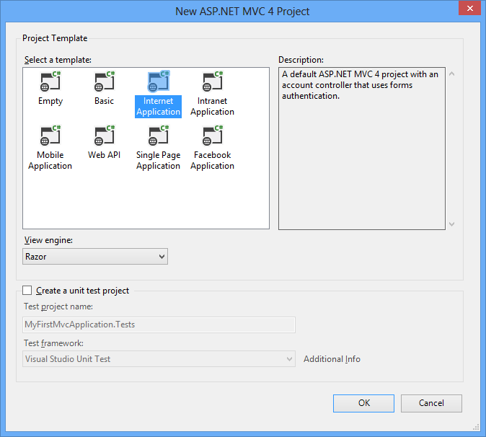
New ASP.NET MVC Project

Slide 29
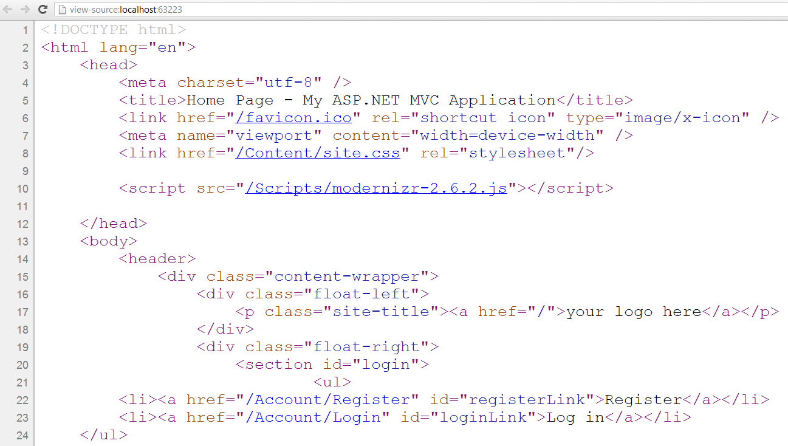
Internet Application Project

Slide 30
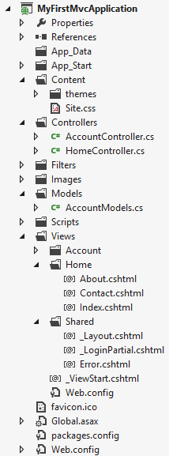
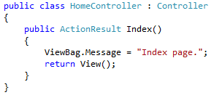
Internet App Project Files
Static files (CSS, Images, etc.)
All controllers and actions
JavaScript files (jQuery, Modernizr, knockout, etc.)
View templates
_Layout.cshtml – master page (main template)
Application_Start() – The entry point of the application
Configuration file

Slide 31
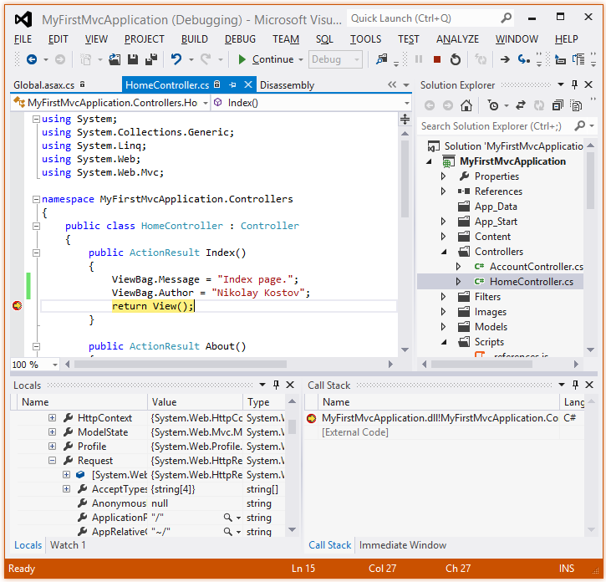
Demo: Internet application
Making changes and debugging

Slide 32
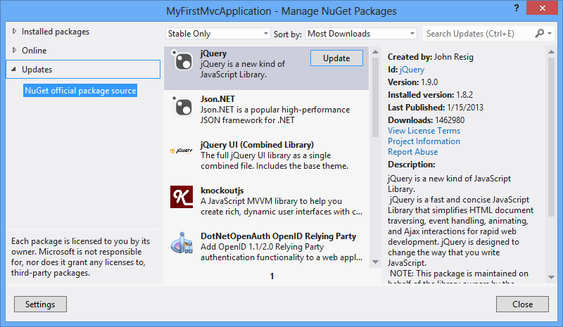
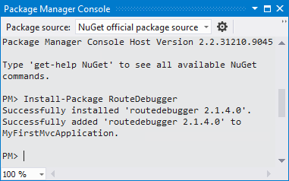
NuGet package management
Free, open source package management
Makes it easy to install and update open source libraries and tools
Part of Visual Studio 2012
Configurable package sources
Simple as adding a reference
GUI-based package installer
Package manager console

Slide 33
Demo: NuGet
Install and update packages as easy as adding a reference

Slide 34
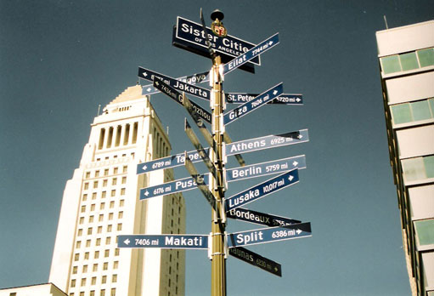
ASP.NET MVC Routing

Slide 35
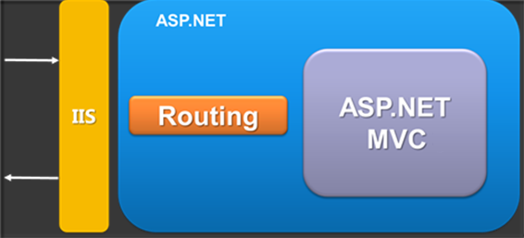
ASP.NET MVC Routing
Mapping between patterns and a combination of controller + action + parameters
Routes are defined as a global list of routes
System.Web.Routing.RouteTable.Routes
Something similar to Apache mod_rewrite
Greedy algorithm
the first match wins

Slide 36
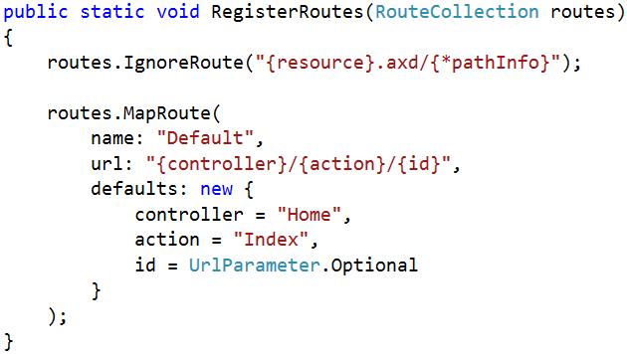
Register routes
In Global.asax in the Application_Start() there is RouteConfig.RegisterRoutes(RouteTable.Routes);
RoutesConfig class is located in /App_Start/ in internet applications template by default
Routes to ignore
The [*] means all left
Route name
Route pattern
Default parameters

Slide 37
Routing Examples
http://localhost/Products/ById/3
Controller: Products
Action: ById
Id: 3

Slide 38
Routing Examples (2)
http://localhost/Products/ById
Controller: Products
Action: ById
Id: 0 (optional parameter)

Slide 39
Routing Examples (3)
http://localhost/Products
Controller: Products
Action: Index
Id: 0 (optional parameter)

Slide 40
Routing Examples (4)
http://localhost/
Controller: Home
Action: Index
Id: 0 (optional parameter)

Slide 41
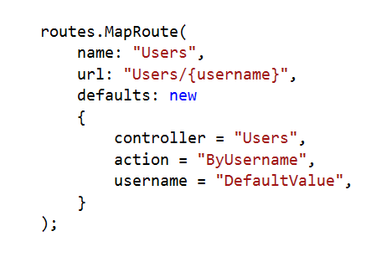
Custom Route
http://localhost/Users/NikolayIT
Controller: Users
Action: ByUsername
Username: NikolayIT

Slide 42
Custom Route (2)
http://localhost/Users
Controller: Users
Action: ByUsername
Username: DefaultValue

Slide 43
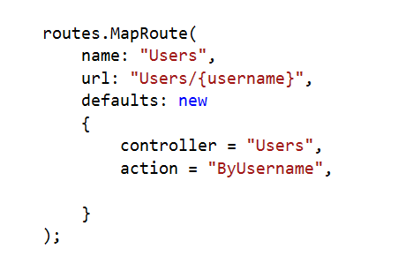
Custom Route (3)
?
http://localhost/Users
Result: 404 Not Found

Slide 44
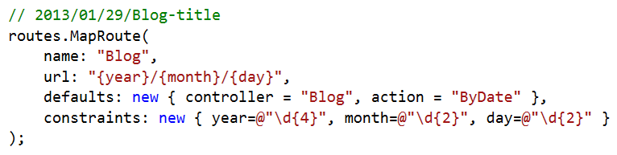
Route Constraints
Constraints are rules on the URL segments
All the constraints are regular expression compatible with class Regex
Defined as one of the routes.MapRoute(…) parameters

Slide 45
Debugging Routes
In actions we have access to a data structure called RouteData
RouteData.Values["controller"]
RouteData.Values["action"]
RouteData.Values["id"]
We can use NuGet package RouteDebugger
Install-Package RouteDebugger
Web.config: <add key="RouteDebugger:Enabled" value="true" />

Slide 46
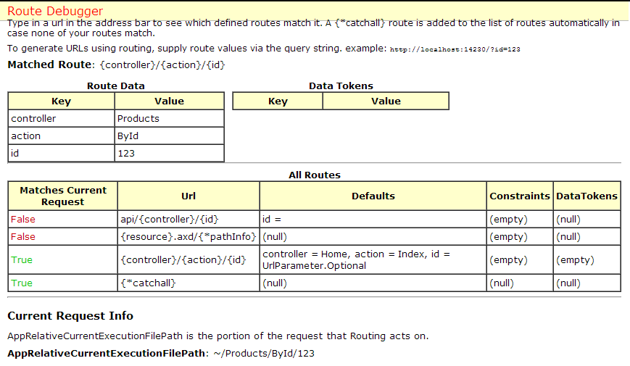
Demo: Routes
ASP.NET MVC Routing

Slide 47
Controllers and Actions
The brain of the application

Slide 48
Controllers
The core component of the MVC pattern
All the controllers should be available in a folder by name Controllers
Controller naming standard should be "nameController" (convention)
Routers instantiate controllers in every request
All requests are mapped to a specific action
Every controller should inherit Controller class
Access to Request (context) and HttpContext

Slide 49
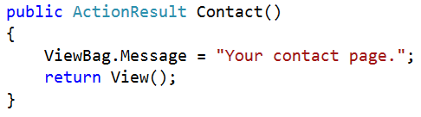
Actions
Actions are the ultimate request destination
Public controller methods
Non-static
No return value restrictions
Actions typically return an ActionResult

Slide 50
Action Results
Controller action response to a browser request
Inherits from the base ActionResult class
Different results types:
Name | Framework Behavior | Producing Method
ContentResult | Returns a string literal | Content
EmptyResult | No response
FileContentResult FilePathResult FileStreamResult | Return the contents of a file | File

Slide 51
Action Results (2)
Name | Framework Behavior | Producing Method
HttpUnauthorizedResult | Returns an HTTP 403 status
JavaScriptResult | Returns a script to execute | JavaScript
JsonResult | Returns data in JSON format | Json
RedirectResult | Redirects the client to a new URL | Redirect / RedirectPermanent
RedirectToRouteResult | Redirect to another action, or another controller’s action | RedirectToRoute / RedirectToAction
ViewResult PartialViewResult | Response is the responsibility of a view engine | View / PartialView

Slide 52
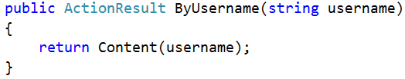
Action Parameters
ASP.NET MVC maps the data from the HTTP request to action parameters in few ways:
Routing engine can pass parameters to actions
http://localhost/Users/NikolayIT
Routing pattern: Users/{username}
URL query string can contains parameters
/Users/ByUsername?username=NikolayIT
HTTP post data can also contain parameters

Slide 53
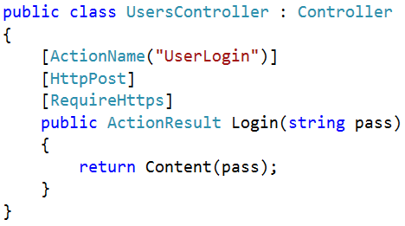
Action Selectors
ActionName(string name)
AcceptVerbs
HttpPost
HttpGet
HttpDelete
HttpOptions
…
NonAction
RequireHttps
ChildActionOnly – Only for Html.Action()

Slide 54
Action Filters
Apply pre- and post-processing logic
Can be applied to actions and to controllers
Global filters can be registered in GlobalFilters. Filters (or in /App_Start/FilterConfig.cs)
Name | Description
OutputCache | Cache the output of a controller
ValidateInput(false) | Turn off request validation and allow dangerous input (html tags)
Authorize | Restrict an action to authorized users or roles
ValidateAntiForgeryToken | Helps prevent cross site request forgeries
HandleError | Can specify a view to render in the event of an unhandled exception

Slide 55

Custom Action Filter
Create C# class file in /Filters/
Inherit ActionFilterAttribute
We can override:
OnActionExecuting(ActionExecutingContext)
OnActionExecuted(ActionExecutedContext)
OnResultExecuting(ResultExecutingContext)
OnResultExecuted(ResultExecutedContext)
We can apply our new attribute to a controller, method or globally in GlobalFilters.Filters

Slide 56
Custom Action Filter (2)
public class LogAttribute : ActionFilterAttribute
{
public override void OnActionExecuting (ActionExecutingContext filterContext) { /* */ }
public override void OnActionExecuted (ActionExecutedContext filterContext) { /* */ }
public override void OnResultExecuting (ResultExecutingContext filterContext) { /* */ }
public override void OnResultExecuted (ResultExecutedContext filterContext) { /* */ }
}
[Log]
public class DepartmentController : Controller { // ... }

Slide 57
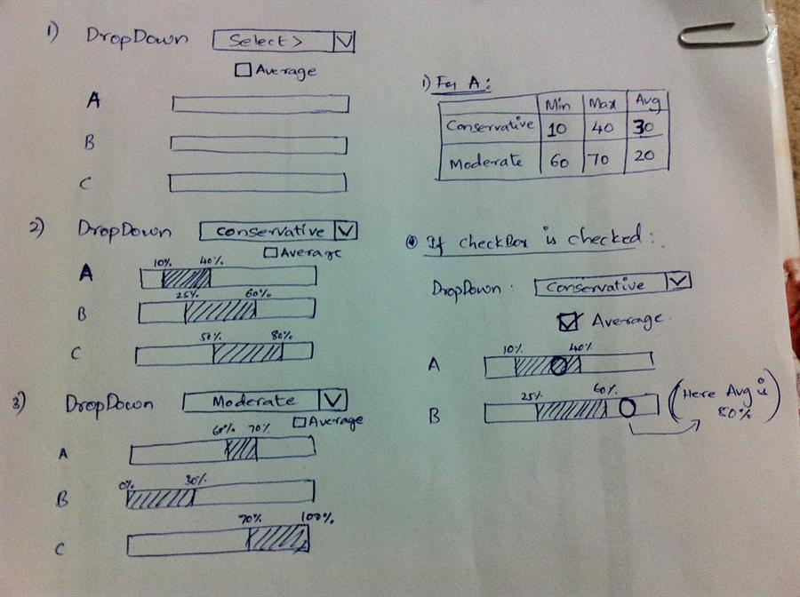
Razor Views

Slide 58
Views
HTML templates of the application
A lot of view engines available
View engines execute code and provide HTML
Provide a lot of helpers to easily generate HTML
The most popular is Razor and WebForms
We can pass data to views through ViewBag, ViewData and Model (strongly-typed views)
Views support master pages (layout views)
Other views can be rendered (partial views)

Slide 59
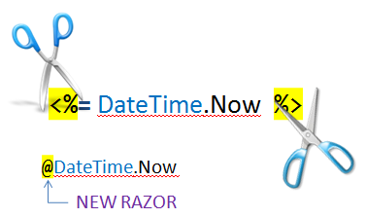
Razor
Template markup syntax
Simple-syntax view engine
Based on the C# programming language
Enables the programmer to use an HTML construction workflow
Code-focused templating approach, with minimal transition between HTML and code
Razor syntax starts code blocks with a @ character and does not require explicit closing of the code-block

Slide 60
Design Goals
Compact, Expressive, and Fluid
Smart enough to differ HTML from code
Easy to Learn
Is not a new language
Works with any Text Editor
Has great Intellisense
Built in Visual Studio
Unit Testable
Without requiring a controller or web-server
Template
+
Data
=
Generated Output

Slide 61
Pass Data to a View
With ViewBag (dynamic type):
Action: ViewBag.Message = "Hello World!";
View: @ViewBag.Message
Strongly-typed views:
Action: return View(model);
View: @model ModelDataType;
With ViewData (dictionary)
ViewData["message"] = "Hello World!";
View: @ViewData["message"]

Slide 62
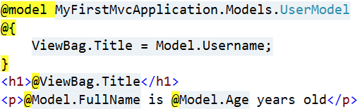

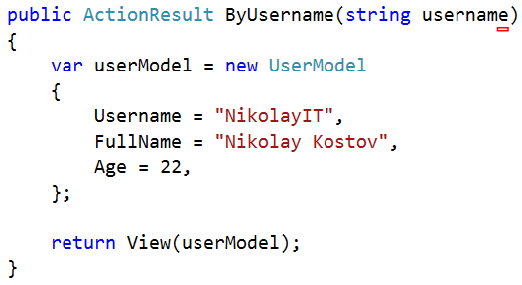
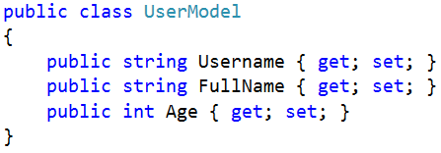
How it works?
ByUsername.cshtml
HTML Output
Template
+
Data
=
Generated Output
UsersController.cs
UserModel.cs

Slide 63
Razor Syntax
@ – For values (HTML encoded)
@{ … } – For code blocks (keep the view simple!)
<p>
Current time is: @DateTime.Now!!!
Not HTML encoded value: @Html.Raw(someVar)
</p>
@{
var productName = "Energy drink";
if (Model != null)
{
productName = Model.ProductName;
}
else if (ViewBag.ProductName != null)
{
productName = ViewBag.ProductName;
}
}
<p>Product "@productName" has been added in your shopping cart</p>

Slide 64
Razor Syntax (2)
If, else, for, foreach, etc. C# statements
HTML markup lines can be included at any part
@: – For plain text line to be rendered
<div class="products-list">
@if (Model.Products.Count() == 0)
{
<p>Sorry, no products found!</p>
}
else
{
@:List of the products found:
foreach(var product in Model.Products)
{
<b>@product.Name, </b>
}
}
</div>

Slide 65
Razor Syntax (3)
Comments
What about "@" and emails?
@*
A Razor Comment
*@
@{
//A C# comment
/* A Multi
line C# comment
*/
}
<p>
This is the sign that separates email names from domains: @@<br />
And this is how smart Razor is: spam_me@gmail.com
</p>

Slide 66
Razor Syntax (4)
@(…) – Explicit code expression
@using – for including namespace into view
@model – for defining the model for the view
<p>
Current rating(0-10): @Model.Rating / 10.0 @* 6 / 10.0 *@
Current rating(0-1): @(Model.Rating / 10.0) @* 0.6 *@
spam_me@Model.Rating @* spam_me@Model.Rating *@
spam_me@(Model.Rating) @* spam_me6 *@
</p>
@using MyFirstMvcApplication.Models;
@model UserModel
<p>@Model.Username</p>

Slide 67
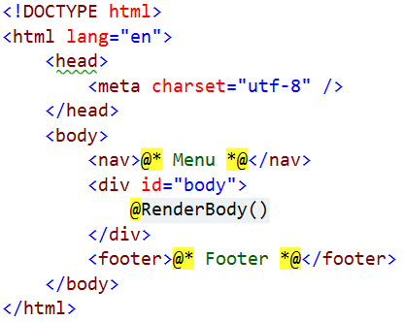
Layout
Define a common site template
Similar to ASP.NET master pages (but better!)
Razor view engine renders content inside-out
First view is redered, then layout
@RenderBody() – indicate where we want the views based on this layout to “fill in” their core content at that location in the HTML

Slide 68
Views and Layouts
Views don't need to specify layout since their default layout is set in their _ViewStart file:
~/Views/_ViewStart.cshtml (code for all views)
Each view can specify custom layout pages
Views without layout:
@{
Layout = "~/Views/Shared/_UncommonLayout.cshtml";
}
@{
Layout = null;
}

Slide 69
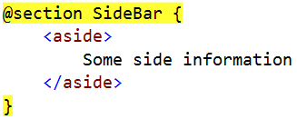
Sections
You can have one or more "sections" (optional)
They are defined in the views:
And may be rendered anywhere in the layout page using the method RenderSection()
@RenderSection(string name, bool required)
If the section is required and not defined, an exception will be thrown (IsSectionDefined())

Slide 70
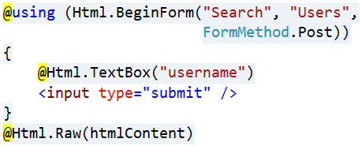
View Helpers
Each view inherits WebViewPage
ViewPage has a property named Html
Html property has methods that return string and can be used to generate HTML
Create inputs
Create links
Create forms
Other helper properties are also available
Ajax, Url, custom helpers

Slide 71
HTML Helpers
Method | Type | Description
BeginForm, BeginRouteForm | Form | Returns an internal object that represents an HTML form that the system uses to render the <form> tag
EndForm | Form | A void method, closes the pending </form> tag
CheckBox, CheckBoxFor | Input | Returns the HTML string for a check box input element
Hidden, HiddenFor | Input | Returns the HTML string for a hidden input element
Password, PasswordFor | Input | Returns the HTML string for a password input element
RadioButton, RadioButtonFor | Input | Returns the HTML string for a radio button input element
TextBox, TextBoxFor | Input | Returns the HTML string for a text input element
Label, LabelFor | Label | Returns the HTML string for an HTML label element

Slide 72
HTML Helpers (2)
Method | Type | Description
ActionLink, RouteLink | Link | Returns the HTML string for an HTML link
DropDownList, DropDownListFor | List | Returns the HTML string for a drop-down list
ListBox, ListBoxFor | List | Returns the HTML string for a list box
TextArea, TextAreaFor | TextArea | Returns the HTML string for a text area
Partial | Partial | Returns the HTML string incorporated in the specified user control
RenderPartial | Partial | Writes the HTML string incorporated in the specified user control to the output stream
ValidationMessage, ValidationMessageFor | Validation | Returns the HTML string for a validation message
ValidationSummary | Validation | Returns the HTML string for a validation summary message

Slide 73
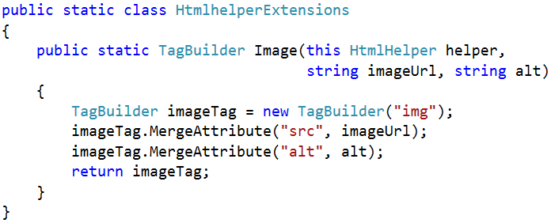

Custom Helpers
Write extension methods for the HtmlHelper
Return string or override ToString method
TagBuilder manages closing tags and attributes
Add namespace in web.config (if needed)

Slide 74
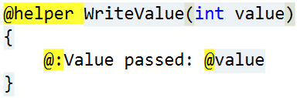
Custom Helpers (2)
Another way to write helpers:
Create folder /App_Code/
Create a view in it (for example Helpers.cshtml)
Write a helper in it using @helper
You can use the helper in any view
You have a lot of code in views? => write helpers

Slide 75
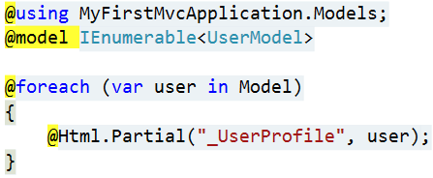
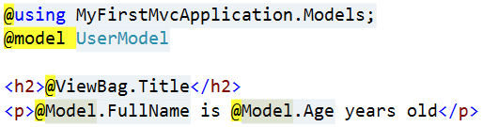
Partial Views
Partial views render portions of a page
Reuse pieces of a view
Html helpers – Partial, RenderPartial and Action
Razor partial views are still .cshtml files
Sub-request
Located in the same folder as other views or in Shared folder

Slide 76
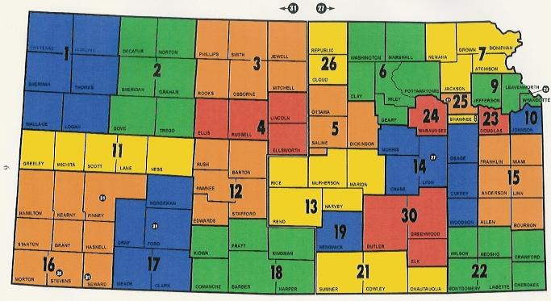
Areas

Slide 77
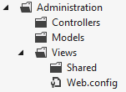
Areas
Some applications can have a large number of controllers
ASP.NET MVC lets us partition Web applications into smaller units (areas)
An area is effectively an MVC structure inside an application
Example: large e-commerce application
Main store, users
Blog, forum
Administration

Slide 78
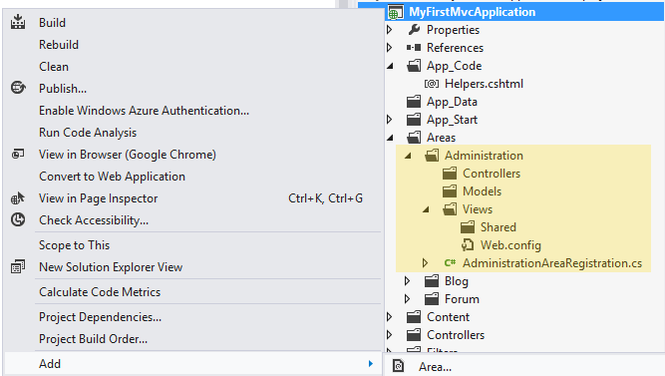
Demo: Areas
ASP.NET MVC structures (areas)

Slide 79

Kendo UI Widgets
http://www.kendoui.com/

Slide 80
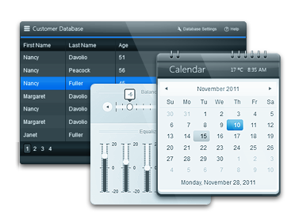
What is Kendo UI?
Framework for building modern interactive web applications
Collection of script files and resources (styles, images, etc.)
Leverages
JavaScript
HTML5
CSS3
jQuery

Slide 81
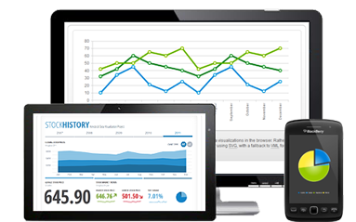
What Does Kendo UI Provide?
Rich UI Widgets
HTML5 controls based on jQuery Core
3 categories of UI Widgets
Web
DataViz
Mobile
Client-side DataSource
Abstraction for working with all types of data on the client side

Slide 82
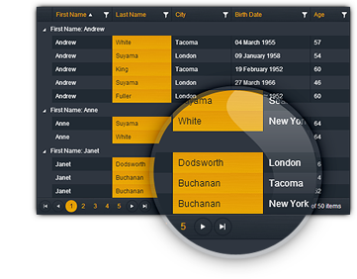
What Does Kendo UI Provide(2)
MVVM Framework
Provides declarative binding and two-way data synchronization in your web application
Animation and Drag & Drop
Templating
Validation Framework
Server wrappers
ASP.NET MVC
Java and PHP

Slide 83
Include Kendo UI in Project
Download it and unzip it (ask us for license)
Kendo UI Complete for ASP.NET MVC
Copy and reference Kendo.Mvc.dll
Located in: ...\wrappers\aspnetmvc\Binaries\Mvc3
Copy JavaScript files into ourProject\Scripts
js\kendo.all.min.js and js\kendo.aspnetmvc.min.js
Copy CSS files and images into our project
All from …\styles to ourProject\Styles\KendoUI

Slide 84
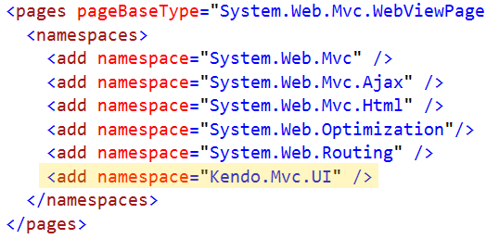
Include Kendo UI in Project (2)
Reference Kendo UI scripts and styles
In Views\Shared\_Layout.cshtml <head>
In Views\Shared\_Layout.cshtml before </body>
Add namespaces in ~/Views/Web.config

Slide 85



Using Kendo UI
Pure HTML and JavaScript
ASP.NET MVC wrappers
Kendo code MUST be after jQuery reference!

Slide 86

Demo: Kendo UI
http://demos.kendoui.com/web/overview/index.html

Slide 87
Summary
Model–view–controller (MVC) is a software architecture pattern
ASP.NET MVC is a great platform for developing internet applications
Routes maps URLs to controllers and actions
Razor views are powerful engine for combining models and templates into HTML code
Our project can be divided into pieces (areas)
KendoUI is a powerful UI library with widgets and can save us time writing them

Slide 88
Introduction to ASP.NET MVC 4
http://schoolacademy.telerik.com

Slide 89



Free Trainings @ Telerik Academy
“C# Programming @ Telerik Academy
csharpfundamentals.telerik.com
Telerik Software Academy
academy.telerik.com
Telerik Academy @ Facebook
facebook.com/TelerikAcademy
Telerik Software Academy Forums
forums.academy.telerik.com

